Slide 2
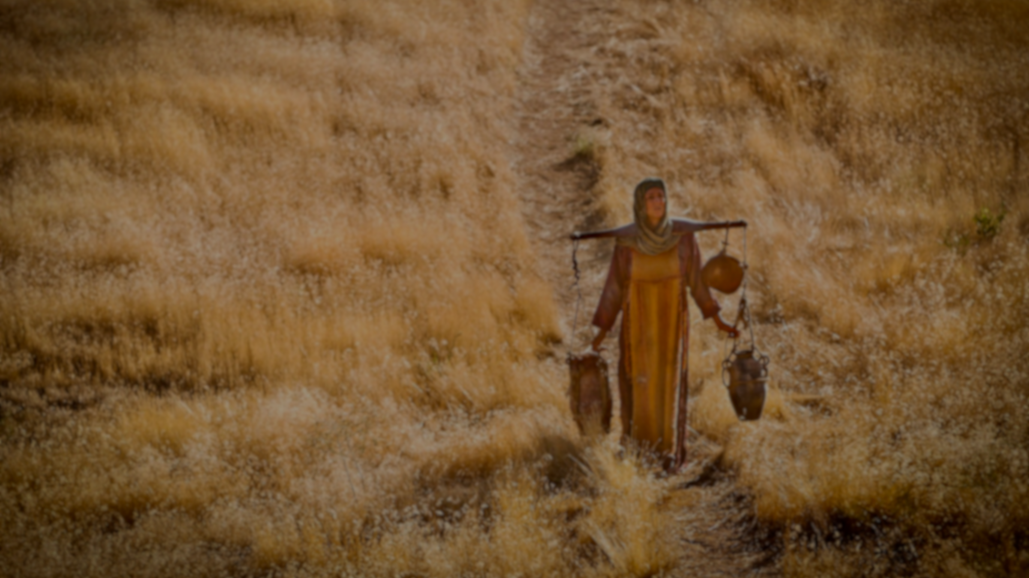
约翰福音 John 4：7
有一个撒玛利亚的妇人来打水。耶稣对她说，请你给我水喝。When a Samaritan woman came to draw water, Jesus said to her, “Will you give me a drink?”

Slide 3
效法耶稣传福音
Imitate Jesus to evangelize
1. 没有顾虑
No worries
2. 愿付代价
Willing to pay the price
3. 懂得引导对方
Know how to guide the other party

Slide 4
约翰福音 John 4：13-14
13 耶稣回答说，凡喝这水的，还要再渴。
13 Jesus answered, “Everyone who drinks this water will be thirsty again,

Slide 5
14 人若喝我所赐的水就永远不渴。我所赐的水，要在他里头成为泉源，直涌到永生。
14 but whoever drinks the water I give them will never thirst. Indeed, the water I give them will become in them a spring of water welling up to eternal life.”

Slide 6
约翰福音 John 4：16
16 耶稣说，你去叫你丈夫也到这里来。
16 He told her, “Go, call your husband and come back.”

Slide 7
约翰福音 John 4：24-26
24 神是个灵所以拜他的，必须用心灵和诚实拜他。
24 God is spirit, and his worshipers must worship in the Spirit and in truth.”

Slide 8
25 妇人说，我知道弥赛亚，要来。他来了，必将一切的事都告诉我们。
25 The woman said, “I know that Messiah” “is coming. When he comes, he will explain everything to us.”
26 耶稣说，这和你说话的就是他。
26 Then Jesus declared, “I, the one speaking to you—I am he.”

Slide 9
约翰福音 John 4：28-30
28 那妇人就留下水罐子，往城里去，对众人说，
28 Then, leaving her water jar, the woman went back to the town and said to the people,

Slide 10
29 你们来看，有一个人将我素来所行的一切事，都给我说出来了，莫非这就是基督吗？
29 “Come, see a man who told me everything I ever did. Could this be the Messiah?”

Slide 11
30 众人就出城往耶稣那里去。
30 They came out of the town and made their way toward him.

Slide 12
你们来看！ Come and see!

Slide 13
你有没有看！
Did you watch it!
开心小站
Hppy little station

Slide 17
小视频进入 small video
千家万户
Thousands of households

Slide 20
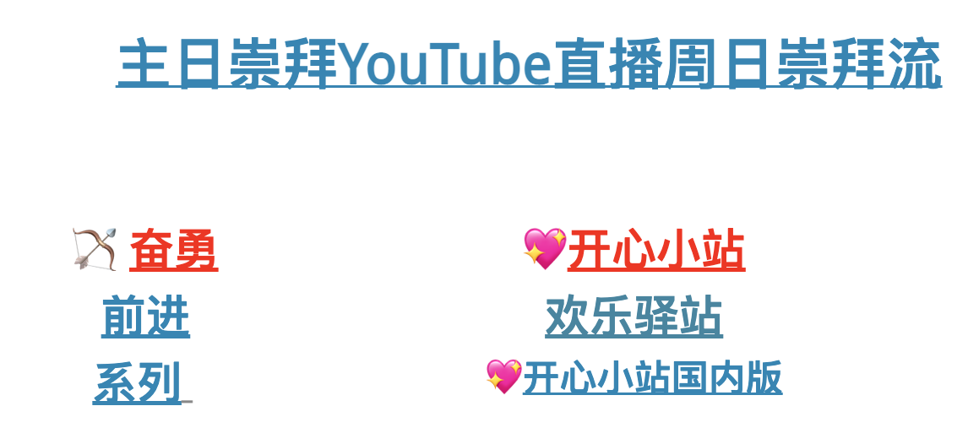
教会網站
https: www.louisvilleccc.org

